Slide 1

Full Stack Social Media Market place
Buy & Sell Platform using PERN Stack
Presented by: Mohak, Poojam, Preet, Shravan,Gayatri
Panel : A
Subject : FSD-L

Slide 2
PROBLEM STATEMENT
Connecting users through a digital buying-selling ecosystem
This project presents a complete full-stack social media marketplace platform designed to enable users to buy and sell products efficiently online.
It is developed using the PERN stack, which includes PostgreSQL, Express.js, React.js, and Node.js for scalable performance.
The system integrates frontend, backend, and database components to provide a seamless and interactive user experience.
The application simulates a real-world online marketplace similar to OLX and Facebook Marketplace platforms.
The main objective is to provide a fast, secure, and user-friendly platform for digital buying and selling.

Slide 3
AIM, USERS AND NEEDS
Why is it required..
AIM ::
To design and develop a full-stack social media marketplace platform
To enable users to buy and sell products easily through a web application
To implement real-time interaction between buyers and sellers
To understand integration of frontend, backend, and database systems
Target Users & Needs ::
Buyers: Users looking to purchase products online
Sellers: Individuals or businesses listing products for sale
General Users: Anyone who wants a simple and fast marketplace experience
User Needs ::
Easy registration and login system
Ability to add and manage product listings
Fast search and filtering options
Secure and reliable platform for transactions, Responsive design for mobile and desktop users

Slide 4
Project OBJECTIVES
Why is it being built..
The objective of this project is to design and implement a highly responsive and interactive frontend using React to enhance user experience, improve usability, and ensure smooth navigation across different devices.
Another objective is to develop efficient backend APIs using Node.js and Express that handle user requests, process data securely, and ensure seamless communication between frontend and database layers.
The system aims to implement strong authentication mechanisms such as JWT-based login systems to ensure user data security, prevent unauthorized access, and maintain privacy across the platform.
It also focuses on enabling complete CRUD operations, allowing users to create, update, delete, and manage product listings easily through an intuitive and user-friendly interface.
The project further aims to ensure proper integration between frontend, backend, and database components to maintain consistency, reliability, and efficient overall system performance.
Goal: Build a secure, scalable marketplace connecting buyers and sellers efficiently.

Slide 5
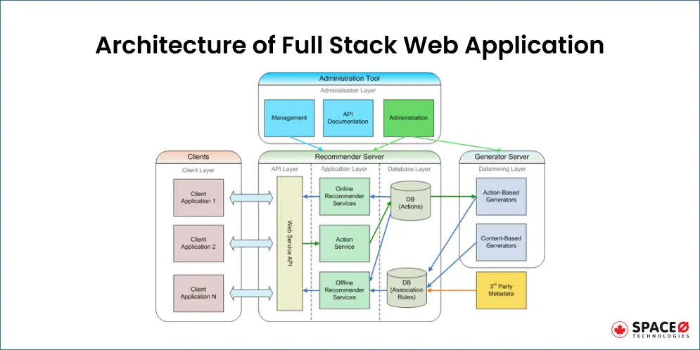
TECH STACK USED
Technologies of the system..
PostgreSQL: Relational database,
Stores structured data (users, products)
Express.js: Backend framework,
Handles API requests and routing
React.js: Frontend library,
Builds interactive UI components
Node.js: Server-side runtime,
Executes backend logic

Slide 6
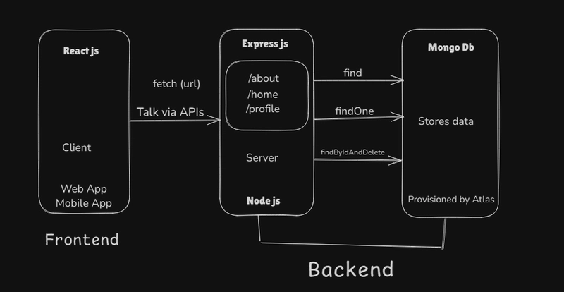
System Architecture
Representing the system flow
Presentation Layer:
Built using React
Handles user interface and interaction
Application Layer:
Built using Node.js and Express
Processes requests and executes business logic
Data Layer:
PostgreSQL database
Stores all application data
This architecture ensures modularity, scalability, and maintainability.

Slide 7
SYSTEM WORKFLOW
Step by step process..
1️⃣ User Authentication : User registers or logs in using credentials
Backend verifies data and provides secure access
2️⃣Product Submission : User enters product details (title, price, description, image)
Data is collected through frontend form
3️⃣API Communication : Frontend sends request to backend using HTTP
APIsData is transferred in structured format (JSON)
4️⃣Backend Processing : Backend validates input and checks user authorization
Applies business logic before storing data
5️⃣Database Storage : Data is stored in PostgreSQL in structured tables
Ensures data consistency and reliability
6️⃣ Data Retrieval & Display : Other users request listings
Backend fetches data and frontend displays it dynamically

Slide 8
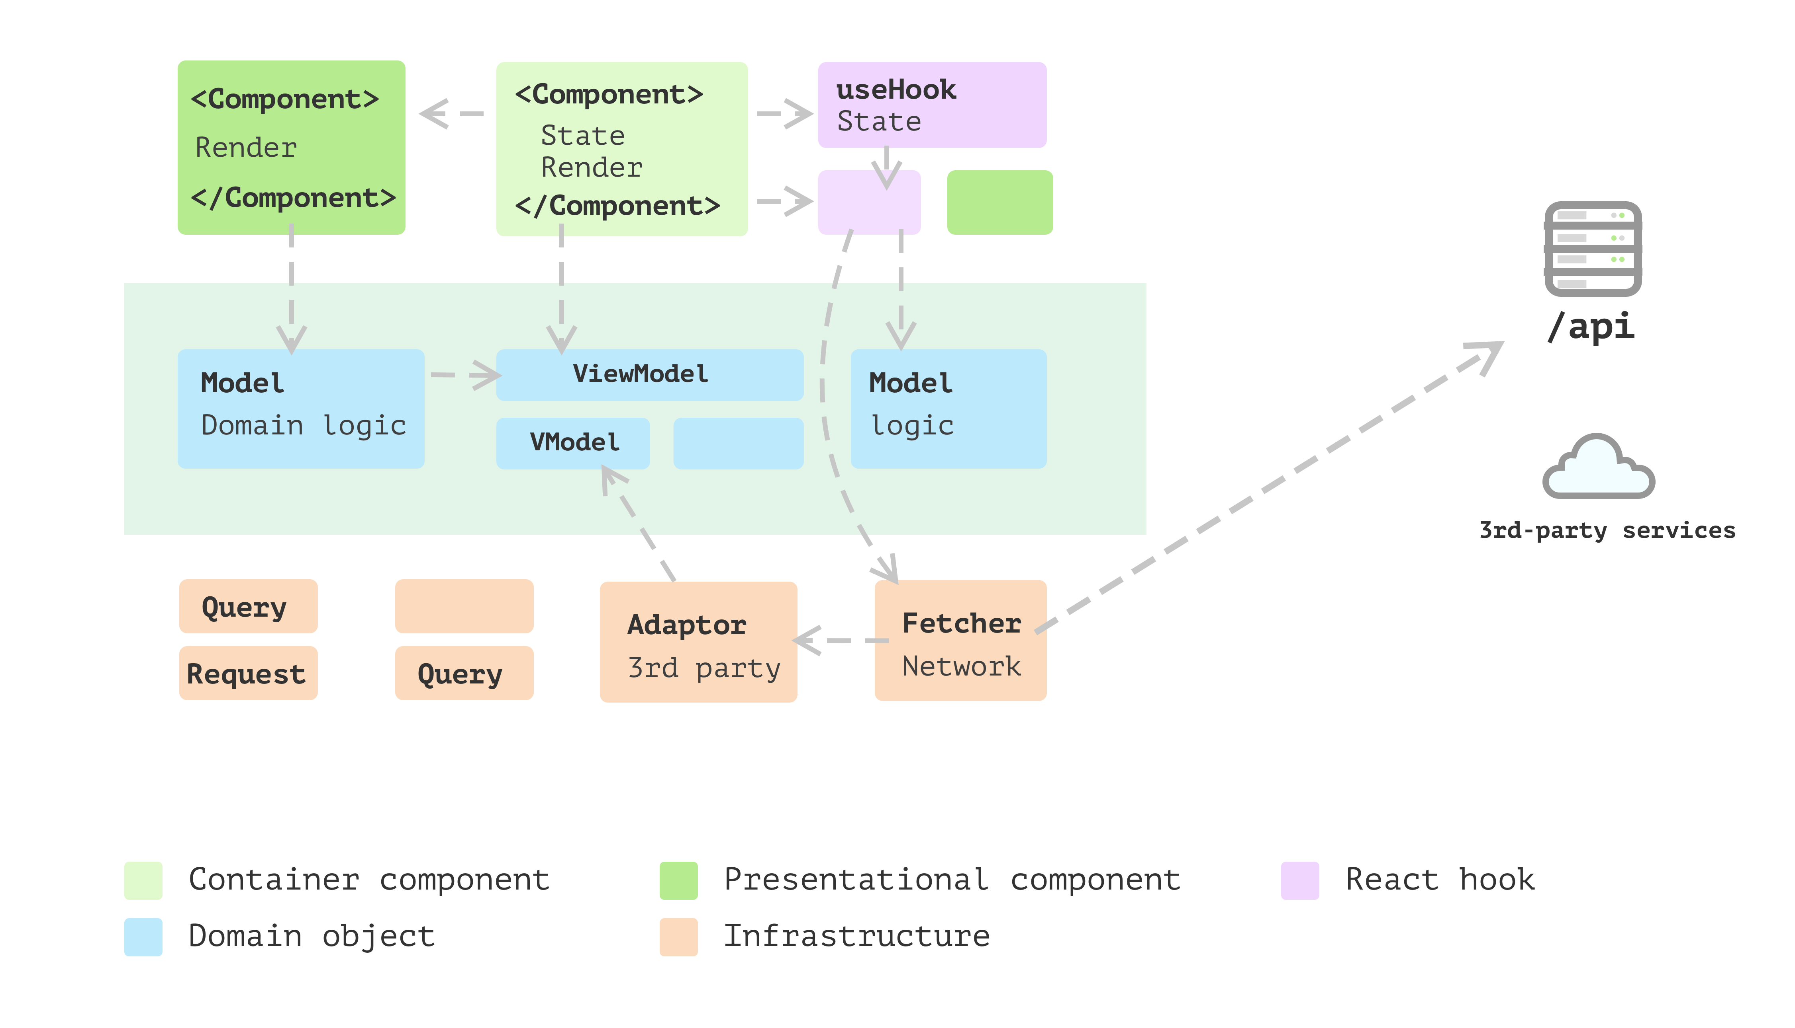
FRONTEND FRAMEWORK
What all you see and experience..
The frontend is developed using React, which uses a component-based architecture to create reusable UI elements efficiently.
React hooks such as useState and useEffect are used to manage application state and lifecycle events effectively.
React Router is implemented to allow smooth navigation between different pages without reloading the application.
Axios is used for making API calls and handling communication between frontend and backend services.
The frontend ensures a dynamic, fast, and interactive user experience

Slide 9
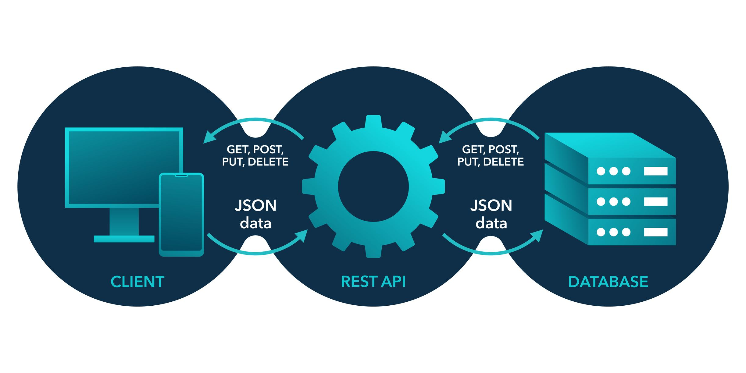
BACKEND FRAMEWORK
The backbone of the project..
The backend is developed using Node.js and Express.js, which handle API requests and server-side logic efficiently.
It processes user inputs, applies validation rules, and executes business logic before storing data in the database.
Middleware functions are used for authentication, request handling, and error management within the application.
The backend acts as a bridge between frontend and database, ensuring secure and efficient data communication.
It ensures proper data flow and maintains system stability.

Slide 10
Database & AUTHENTICATION
Privacy – Not at risk..
PostgreSQL is used as a relational database that stores structured data such as users and product listings in tables.
It ensures data integrity by maintaining relationships between different entities such as users and products.
SQL queries are used to perform operations like inserting, updating, and retrieving data efficiently.
The database ensures consistency, reliability, and efficient management of large amounts of data.
It plays a crucial role in maintaining application performance and stability.
The system uses JWT-based authentication to ensure secure login and access control for users.
After successful login, a token is generated and sent to the client for future authentication requests.
The token is verified on each request to ensure that only authorized users can access protected resources.
This approach prevents unauthorized access and ensures security of sensitive user information.
It enhances overall system security and user trust.

Slide 11
System DASHBOARDS
What all the system offers..
📊 1. AUTHENTICATION PAGES ::
This includes Login Page and Register Page, where users create accounts and access the system securely.
Uses backend validation and token-based authentication for secure access.
👤 2. USER DASHBOARD / HOME PAGE ::
This is the main page for normal users, where they can browse all available product listings.
Users can search, filter, and view products dynamically fetched from the backend database.
🛒 3. PRODUCT LISTING / SELLER DASHBOARD ::
This section allows sellers to add, edit, and delete their product listings.
Users can upload product details like title, price, description, and images.
📄 4. PRODUCT DETAILS PAGE ::
When a user clicks on a product, this page shows detailed information about that specific item.
Includes description, price, seller details, and images.
🛠️ 5. ADMIN DASHBOARD ::
Admin can manage users, listings, and platform activity.
Provides control over deleting inappropriate content or managing users

Slide 12
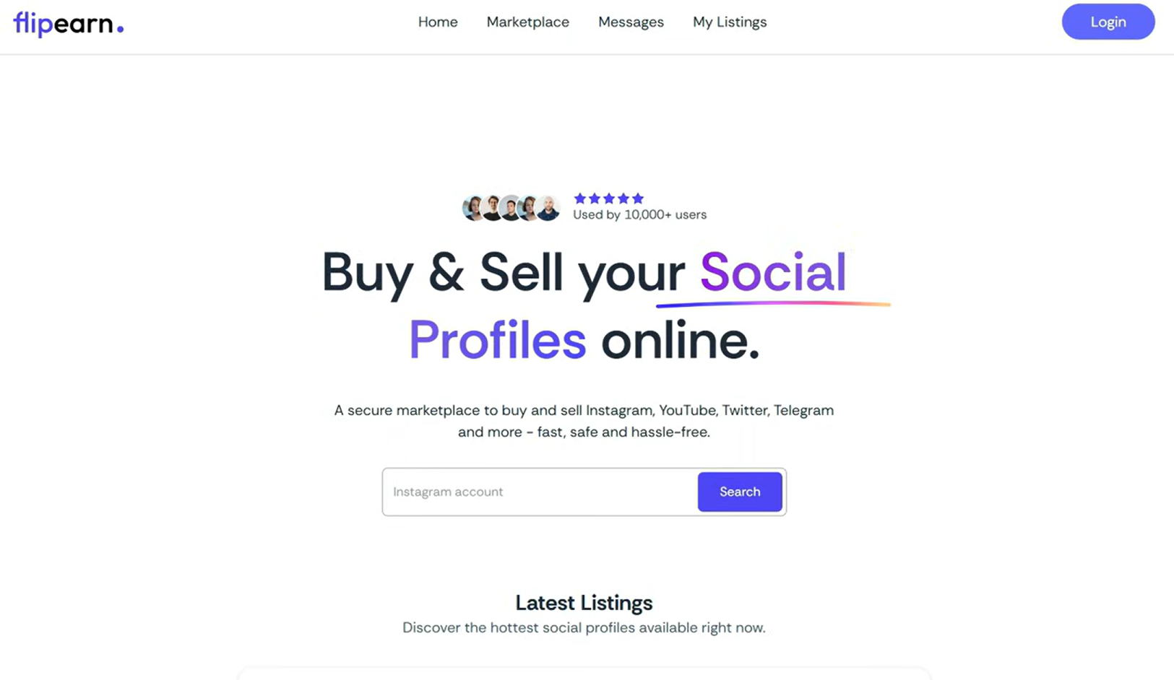
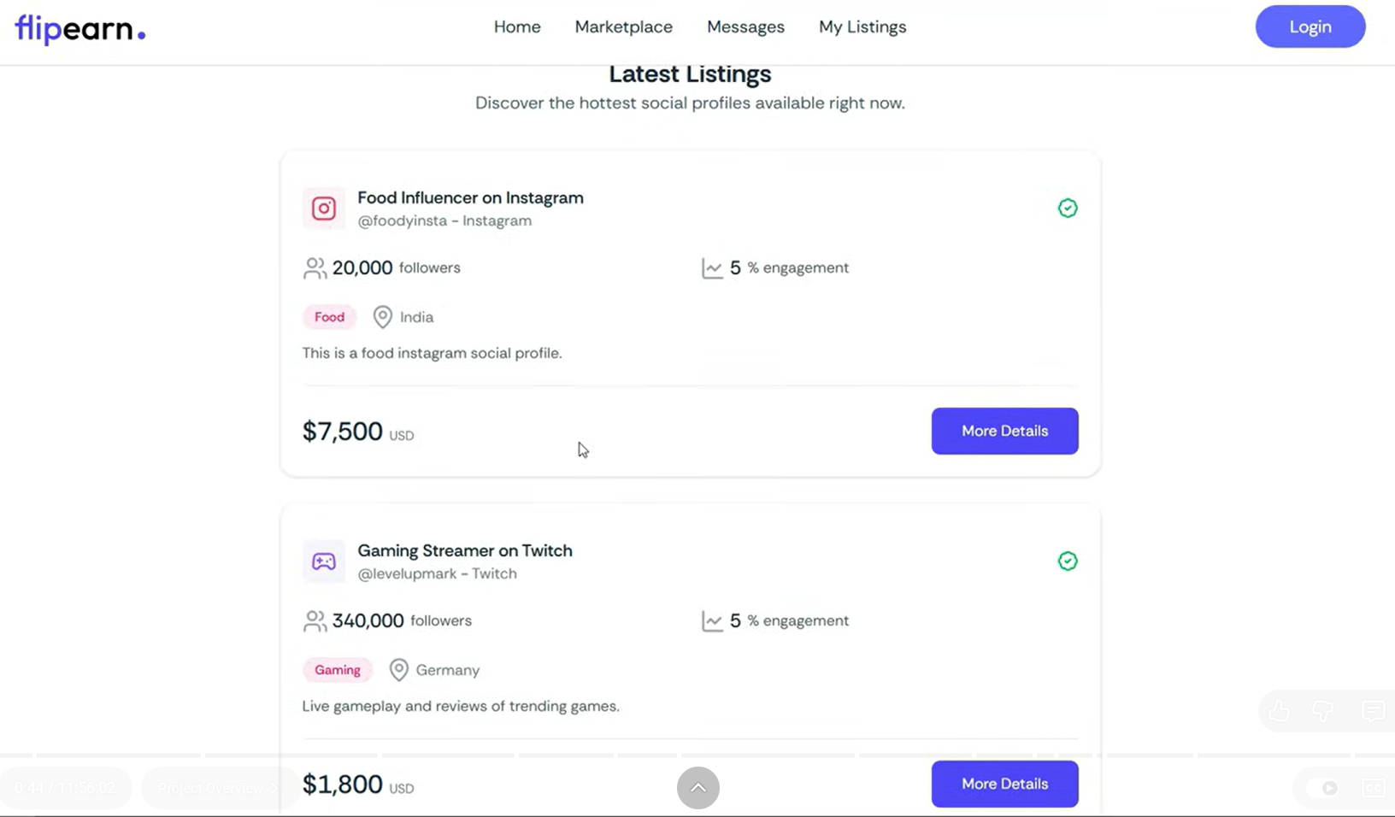
BASIC UI IDEA

Slide 13
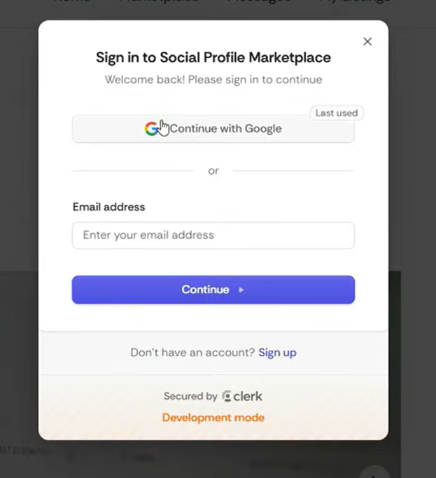
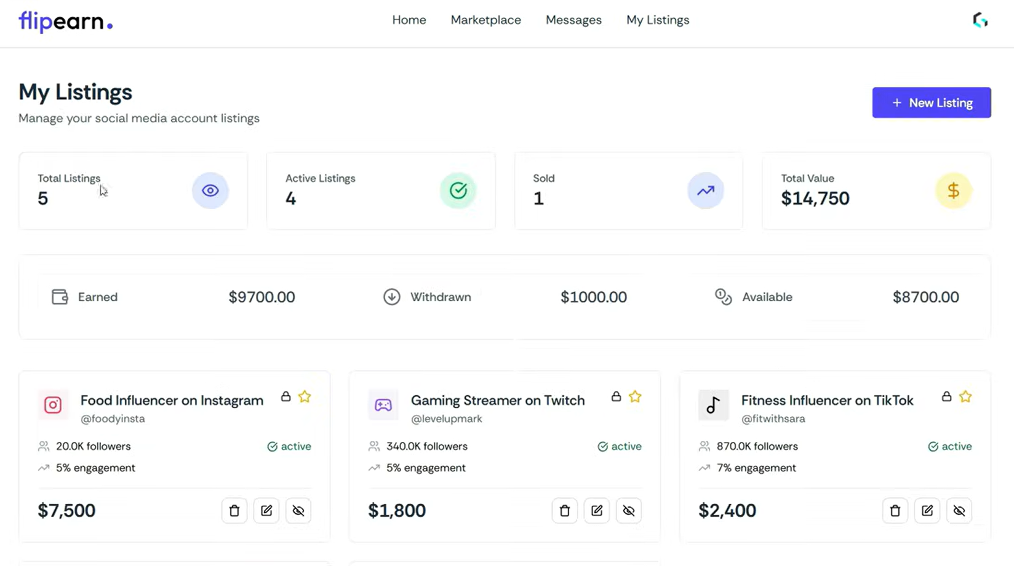
BASIC UI IDEA

Slide 14
KEY FEATURES
Highlights of the project..
The system provides a secure authentication mechanism that allows users to register, log in, and access personalized features safely.
Users can create, update, and delete product listings with detailed information including title, price, description, and images.
The platform includes advanced search and filtering functionality that helps users quickly find products based on their preferences.
It supports image uploads, enabling sellers to visually represent their products and improve user engagement.
The application is fully responsive and works efficiently across different devices including mobile phones, tablets, and desktop systems.
The system dynamically updates product listings in real time, ensuring users always see the latest available products.

Slide 15
FUTURE SCOPE
A Long way ahead..
The system can be enhanced by integrating a secure payment gateway to allow users to complete transactions directly within the platform.
A real-time chat system can be implemented to enable direct communication between buyers and sellers for better interaction.
Artificial Intelligence can be used to build recommendation systems that suggest products based on user preferences and behavior.
A mobile application version can be developed to improve accessibility and provide a better user experience on smartphones.
Advanced analytics features can be added to track user behavior and improve system performance and personalization.
Security mechanisms can be further improved by implementing encryption and advanced authentication techniques.

Slide 16
CONCLUSION
Last but not the least..
The project successfully demonstrates the development of a full-stack marketplace application using modern web technologies and tools.
It integrates frontend, backend, and database components effectively to provide a complete and functional system.
The system offers a scalable and efficient solution for online buying and selling of products in a digital environment.
The project provides practical knowledge of PERN stack and helps in understanding real-world application development concepts.
The platform can be extended further with additional features to make it suitable for commercial-level applications.
Overall, the project highlights the importance of full-stack development in building modern and interactive web applications.

Slide 17


THANK YOU VERY MUCH
Every great application starts with a simple idea and a strong purpose.

